Slide 1
Tableau prep
-Ashu Mehta
Database systems

Slide 2
Introduction
Tableau prep: Tableau preparation tool
Tableau prep was created for data preparation
Data preparation is one of the important step for data visualization.
One of the biggest thing which was missing in Tableau data visualization tool.

Slide 3
Using Tableau prep
Using tableau prep is very simple
You can simply drag and drop various components to create a workflow for data cleaning, aggregation and joining etc. to give it to the visualization tool.

Slide 4
Operations you can do with Tableau prep
Take data from multiple sources
Clean the data
Transform data
Create new calculations
Filling up missing data

Slide 5
Example-OrdersData
Connect to OrdersSouth2015
Field list and data preview options
Performing Union
Connecting to other files
Orders_Central
Orders_East
Orders_West

Slide 6
Problems to be fixed
OrdersCentral
Bifurcated dates
Missing Region Field
OrdersWest
Duplicate fields with ‘right’ prefix
Abbreviations used for states
OrderEast
Sales value contains USD

Slide 7
Data cleaning
OrdersCentral
Add clean step
Create calculated fields for-
Region
Order Date
Ship Date
Removing unnecessary fields
Order day, order month, order year
Ship day, ship month, Ship year
Discounts field
Change none to 0
Change data type from string to number(decimal)
Rename clean step

Slide 8
Data cleaning
OrderEast
Add clean step
Remove letters from sales (USD)
Change datatype string to number(decimal)
Rename clean step

Slide 9
Data cleaning
OrdersWest
Remove fields with ‘right’ prefix
Add clean step
Abbreviated state names
Group values-> Manual selection->Done
Rename clean step

Slide 10
Union
Add union step
Merge the Mismatch fields
Rename to All Orders

Slide 11
Adding Return Reason file
Return_reasons_new
Remove fields except-
OrderID, ProductID, Return Reason, Notes
Add clean step
Remove spaces in Notes field
Options-> clean-> trim spaces
Extracting approver names
Options-> Split-> Automatic
Renaming splitted columns to Customer notes and approver names
Group common characters in approver names
Options-> Group-> common characters
Remove notes field

Slide 12
Join
Join Return reason with All Orders
Join clause recommendations- Add OrderID
Click for left join
Note- Red values in ProductID are those which doesn’t have corresponding return value

Slide 13
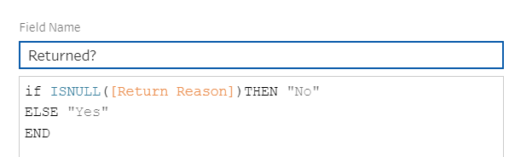
Data Cleaning
Add clean step
Remove ProductID-I and OrderID-I
Create calculated fields
Return reason

Slide 14
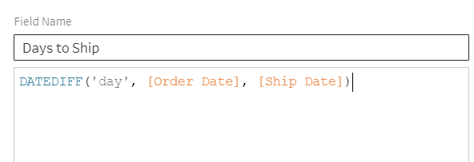
Data Cleaning
Create calculated fields
Days To Ship

Slide 15
Output
Add output step
Specify location
Output type- .csv/.xls
Run flow

